Slide 1
Personalized Quick Decision Maker for TIP Mode of Transportation
Sumilang, Kenneth
Delloson, Renz

Slide 2
Problem Discussion:
Navigating daily transportation decisions can be daunting, especially for university students balancing tight schedules and limited budgets. The problem becomes even more pronounced when a student wakes up and struggles to rationalize the best mode of transportation to get to their first class on time. This scenario necessitates a personalized decision-making tool that considers various factors such as the time of the first class, the student’s budget, and the current time, to recommend the most optimal mode of transportation.

Slide 3
Solution:
Develop a Python program that assists university students in selecting the best mode of transportation each day.

Slide 4
Constraints:
The program will analyze multiple factors including:
Time of First Class: The program will calculate the remaining time before the first class starts and suggest a mode of transportation that ensures timely arrival.
Budget: It will consider the student's budget, recommending affordable options.
Current Time: The real-time traffic and availability of different transportation modes will influence the decision.
A weighted graph representing the route from home to school will be utilized, with weights varying based on the current time, time of the first class, and budget constraints.

Slide 5
Graph:
Taxi
Grab
Home
Timog Ave.
Anonas
T.I.P
E-Rod
Angkas
Araneta

Slide 6
Decomposition
Identify and list all available modes of transportation.Gather and input data for each mode (time, cost, availability).Create a weighted graph of the route from home to school.Implement an algorithm to find the optimal route considering time and cost.
Iteration 1
Problem Identification:
Problem Identification
How can we analyze the current situation of a student waking up and having difficulty deciding on the best mode of transportation to use to reach their university on time, considering the first class, budget, and current time?
Pattern Recognition
Analyzing existing navigation apps that suggest routes based on time and traffic.Using historical data to understand peak times and traffic conditions.Studying budgeting apps that help in managing daily expenses.
Abstraction
Relevant information: first class time, budget, current time, transportation modes.Less relevant information that can be ignored: detailed breakdown of traffic data not directly impacting the route at the current moment.

Slide 7
Decomposition
Define criteria for "best" mode (e.g., shortest time, lowest cost).
Collect and update real-time data (traffic, availability, cost).
Calculate the total travel time for each mode considering current conditions.
Compare costs and travel times to provide the optimal recommendation.
Iteration 2
Problem Identification
I want to develop an algorithm that recommends the best mode of transportation for a student to reach the university on time, based on the first class time, budget, and current time.
Pattern Recognition
Reviewing navigation and transportation apps for real-time data usage.
Analyzing patterns in student transportation choices and timings.
Evaluating budget management tools for effective cost analysis.
Abstraction
Focus on dynamic data inputs: current time, budget, first class schedule.
Ignore static elements that don’t change (e.g., fixed cost of transportation that doesn’t fluctuate daily).

Slide 8
Decomposition
-Test Case 1: Least Cost Optimization
-Test Case 2: Least amount of time
Iteration 2
Problem Identification
How do we define best?
Pattern Recognition
Reviewing navigation and transportation apps for real-time data usage.
Analyzing patterns in student transportation choices and timings.
Evaluating budget management tools for effective cost analysis.
Abstraction
Focus on dynamic data inputs: current time, budget, first class schedule.
Ignore static elements that don’t change (e.g., fixed cost of transportation that doesn’t fluctuate daily).

Slide 9
Decomposition
-Priority 1: not get late
-Priority 2: least amount of money
`
Iteration 2
Problem Identification
How do we define best in the context?
Pattern Recognition
Reviewing navigation and transportation apps for real-time data usage.
Analyzing patterns in student transportation choices and timings.
Evaluating budget management tools for effective cost analysis.
Abstraction
Focus on dynamic data inputs: current time, budget, first class schedule.
Ignore static elements that don’t change (e.g., fixed cost of transportation that doesn’t fluctuate daily).

Slide 10
Decomposition
Iteration 3
Problem Identification
Problem Identification
Pattern Recognition
Abstraction

Slide 11
Decomposition
Iteration 4
Problem Identification
Problem Identification
Pattern Recognition
Abstraction

Slide 12
Decomposition
Iteration 5
Problem Identification
Pattern Recognition
Abstraction

Slide 13
Decomposition
Iteration 1
Problem Identification
Problem Identification
Pattern Recognition
Abstraction

Slide 14
Decomposition
Iteration 1
Problem Identification
Problem Identification
Pattern Recognition
Abstraction

Slide 15
Decomposition
Iteration 1
Problem Identification
Problem Identification
Pattern Recognition
Abstraction

Slide 16
Decomposition
Iteration 1
Problem Identification
Problem Identification
Pattern Recognition
Abstraction

Slide 17
Decomposition
Iteration 1
Problem Identification
Problem Identification
Pattern Recognition
Abstraction

Slide 18
Decomposition
Iteration 1
Problem Identification
Problem Identification
Pattern Recognition
Abstraction

Slide 19
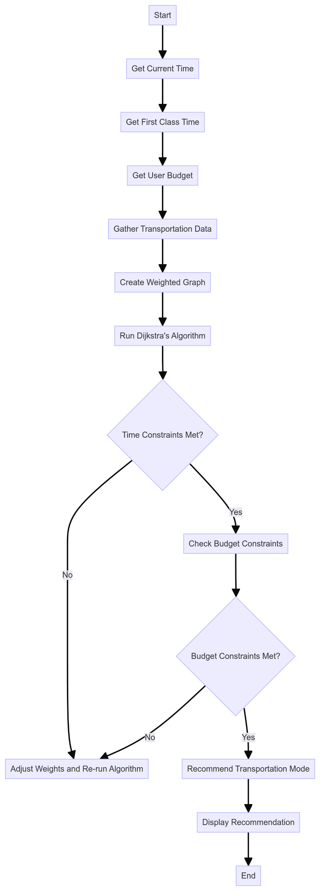
Premade weighted graph
Taxi: 15 minutes
Grab: 15 minutes
Angkas: 15 minutes

